Slide 1

Project Title -Seasonal Agriculture Performance Analysis
Student Name:MOHAMED KASIM A
College Name: IFET COLLEGE OF ENGINEERING
AICTE STU ID :STU6a315d07b88671781619975

Slide 2

PROBLEM STATEMENT
Agricultural performance is influenced by seasonal variations in environmental conditions, farming practices, resource availability, and market conditions. As a result, crop production, resource usage, and economic performance may vary across different seasons.
However, raw agricultural data does not clearly reveal how agricultural performance changes between seasons or what meaningful patterns and relationships exist.
Therefore, this project aims to analyze the agricultural dataset to identify seasonal patterns, trends, relationships, and variations in agricultural performance and provide evidence-based insights for better seasonal agricultural planning.

Slide 3
Project Description The project focuses on analyzing agricultural data collected across different seasons, geographical regions, and farming conditions. The analysis considers factors such as environmental conditions, farming practices, resource usage, crop production, and economic performance. The project involves data exploration, cleaning, statistical analysis, and visualization to understand how agricultural performance changes across seasons. Different seasonal groups are compared to identify important patterns, trends, relationships, variations, and unusual observations. The findings are interpreted to generate evidence-based insights and recommendations that can support better seasonal agricultural planning and decision-making.

Slide 4

WHO ARE THE END USERS?
Farmers – To understand seasonal crop performance and resource usage.
Agricultural Planners – To support evidence-based seasonal planning.
Agricultural Researchers – To study seasonal trends and relationships.
Agricultural Organizations – To evaluate agricultural performance across regions and seasons.
Policy Makers – To use data-driven insights for agricultural planning and decision-making.

Slide 5

Technology Used
Python – Data analysis and processing
Pandas – Data cleaning and manipulation
NumPy – Numerical analysis
Matplotlib – Data visualization
Seaborn – Statistical visualization
Jupyter Notebook – Project development and documentation
CSV Dataset – Agricultural data source

Slide 6
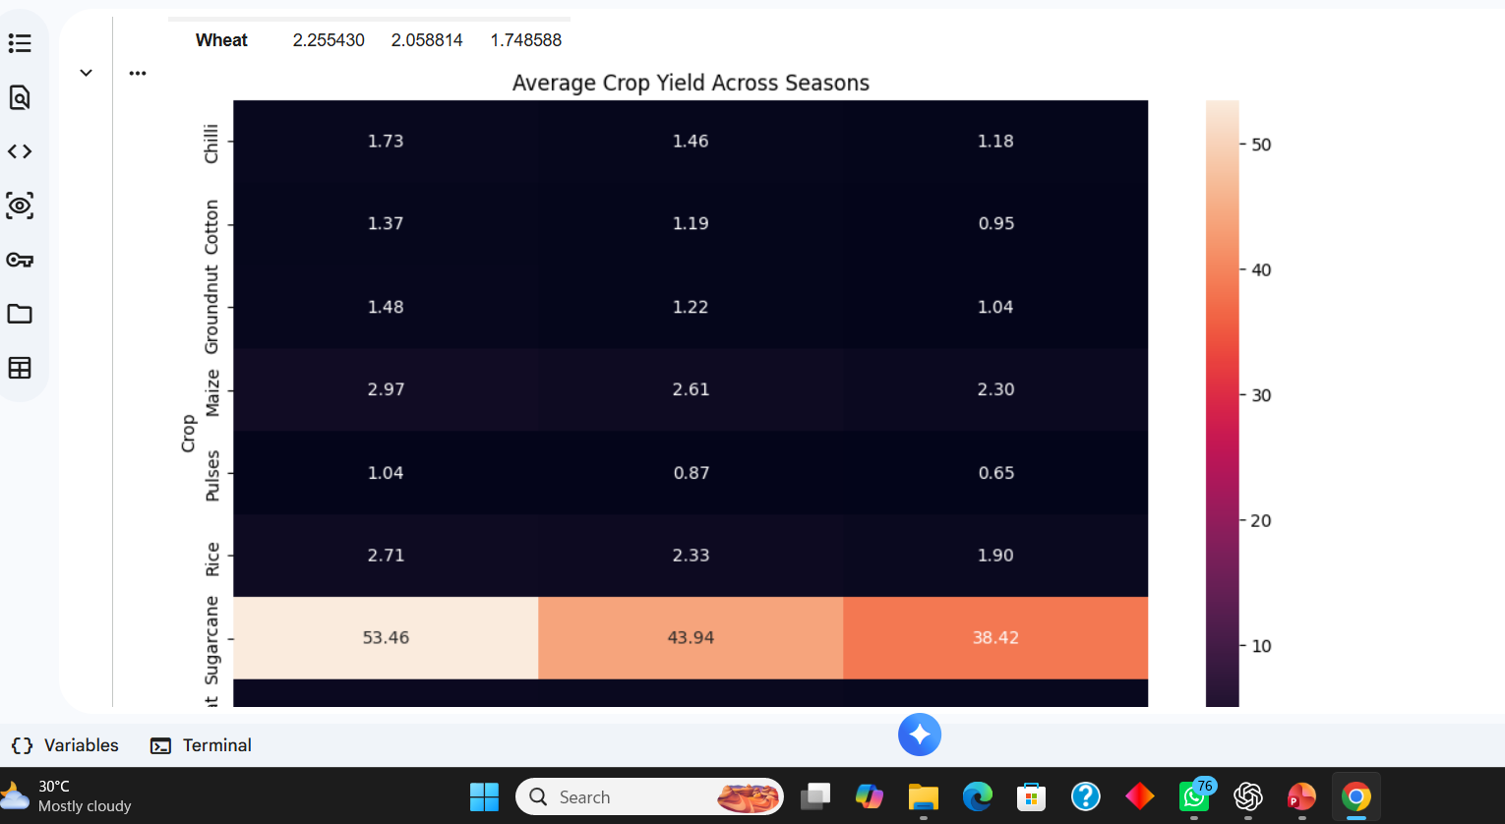
RESULTS

Slide 7
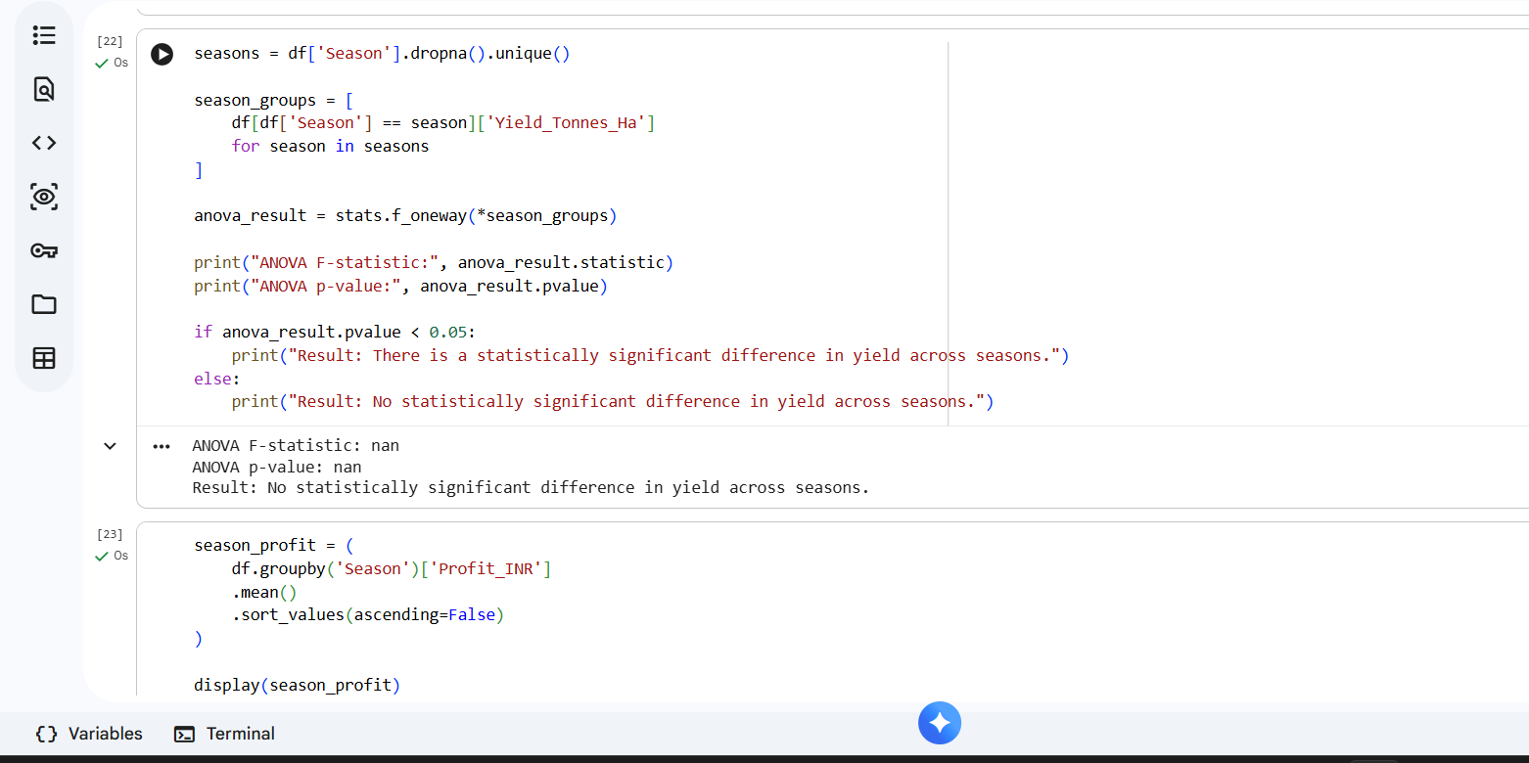
RESULTS

Slide 8
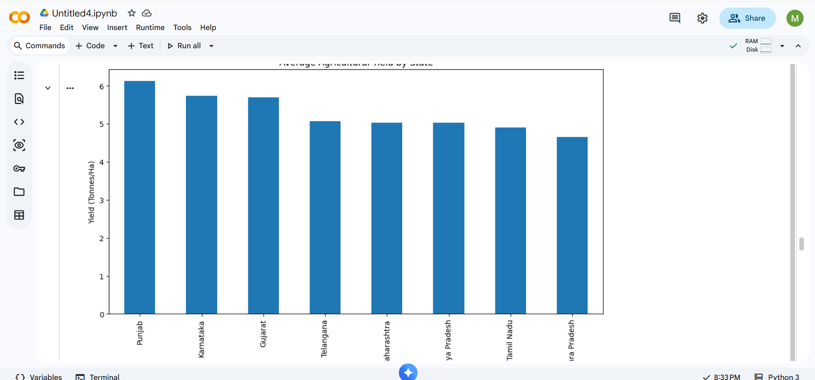
RESULTS

Slide 9
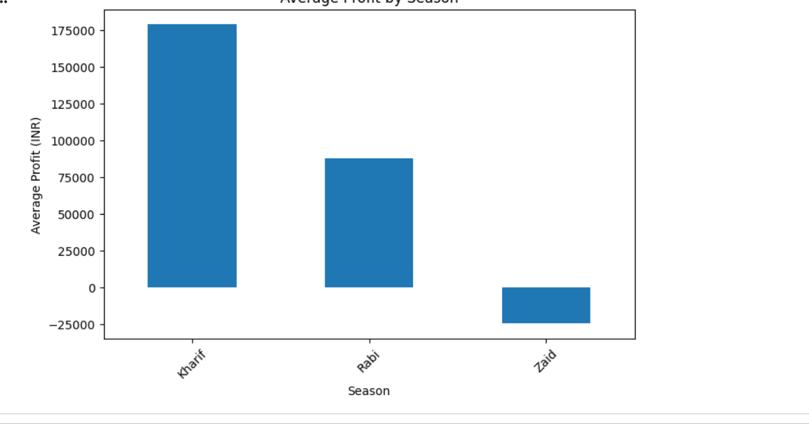
RESULTS

Slide 10
RESULTS

Slide 11
Future scope
Develop a real-time agricultural monitoring system using live environmental and farm data.
Apply machine learning models to predict crop yield and agricultural performance.
Extend the analysis to provide region-specific and season-specific recommendations.
Integrate additional weather, soil, and market data for more accurate analysis.
Develop an interactive dashboard for farmers, researchers, and agricultural planners.
Use historical and real-time data to support better seasonal agricultural planning and decision-making.

Slide 12
GitHub Link
https://github.com/kasimmohamed553/VOIS-Seasonal-Agriculture-Performance-Analysis

Slide 13
VOIS Course completion certificate - Course name- Data Visualization

Slide 14
Thank you
.
.

